Slide 1


SELECTIVE REFLECTION MIRROR
It is what it sounds like!

Slide 2

HOW IT WORKS REALLY?
NO LESS THAN 90, NOT 90. -Why so?
YOU MIGHT SAY IT MULTIPLE REFELCTION, OR ANGULAR MIRROR MANIPULATION.
IT IS ALL ABOUT ANGLES!
JUST KEEP THE MIRRORS AT AN ANGLE

Slide 3

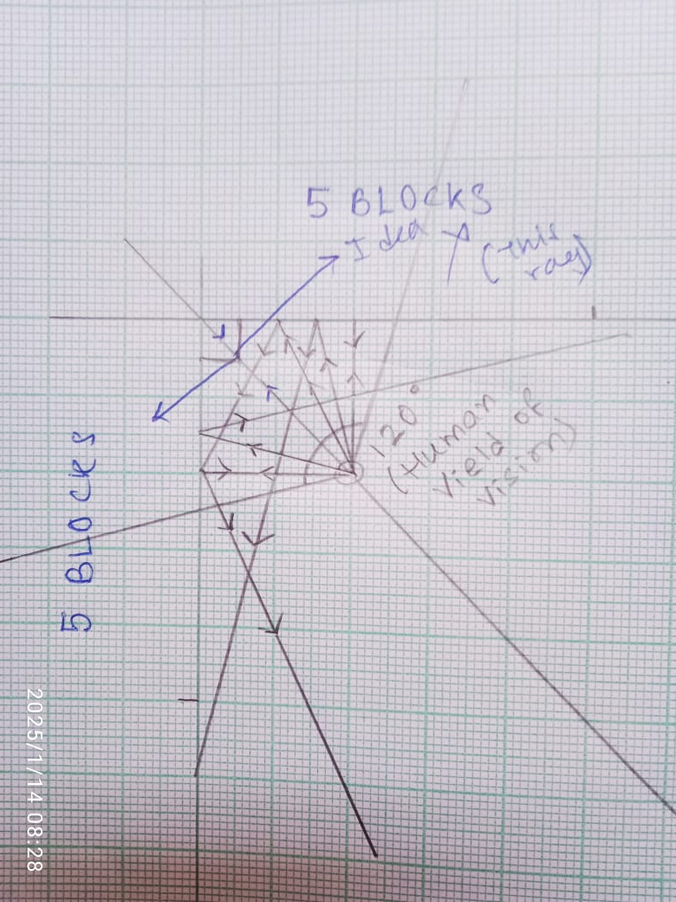
THE FOLLOWING FIGURE DEPICTS IT-
WHY NOT LESS THAN 90 AND 90 ITSELF?

Slide 4

WHY THESE ANGLES?
LET’S PRACTICALLY DEMONSTARTE AND FIND OUT!

Slide 5


THANK YOU!
CONTRIBUTORS- (Arranged alphabetically)
MAINAK BISWAS
TRISHAN BHATTACHARJEE

